Slide 1
Inheritance
K.V. Bhatt,
SBMP

Slide 2
Class v/s Structure
In C++, both structure and class contains data and functions as members
The major difference is “all the members of a class are by default private” whereas “all the members of a structure are by default public”

Slide 3
Class Example
#include <iostream.h>
class Test {
int x; // x is private
};
void main()
{
Test t;
t.x = 20; // compiler error because x is private
}

Slide 4
Structure Example
#include<iostream.h>
struct Test {
int x; // x is public
};
void main()
{
Test t;
t.x = 20; // works fine because x is public
}

Slide 5
Inheritance
The C++ strongly supports reusability.
Once a class has been written and tested, can be used by other programmers.
This is done by creating new classes, reusing the properties of existing ones.
The mechanism of deriving a new class from an old class is called Inheritance.
The old class is referred to as base class or super class and the new one is called the derived class or subclass.

Slide 6
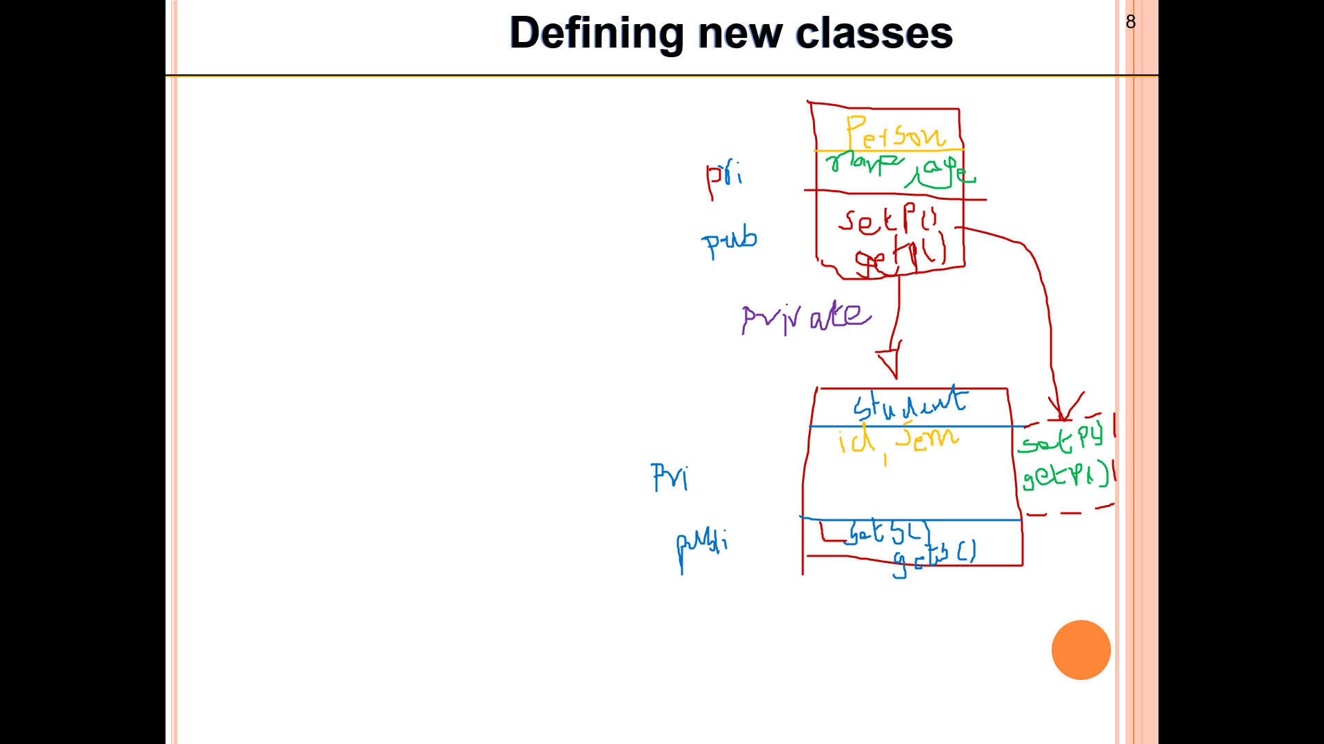
Inheritance
Note:
The derived class inherits some or all of the qualities(traits) of the base class + It possesses its own unique qualities.

Slide 7
Defining new classes
A derived class can be defined by specifying its relationship with the base class as follows:
class derived_class_name : visibility_mode
base_class_name
{
// Members of derived class
}

Slide 8
Defining new classes
: = derived class name is derived from the base class name
visibility_mode
Optional and if present can be one of 3 i.e. private, public, protected
The default visibility mode is private
Features of the base class are publicly, privately or protectedly derived

Slide 9
Defining new classes
Examples:
class ABC : private XYZ
{
// Members of ABC
} ;
Class ABC : public XYZ
{
// Members of ABC
};

Slide 10
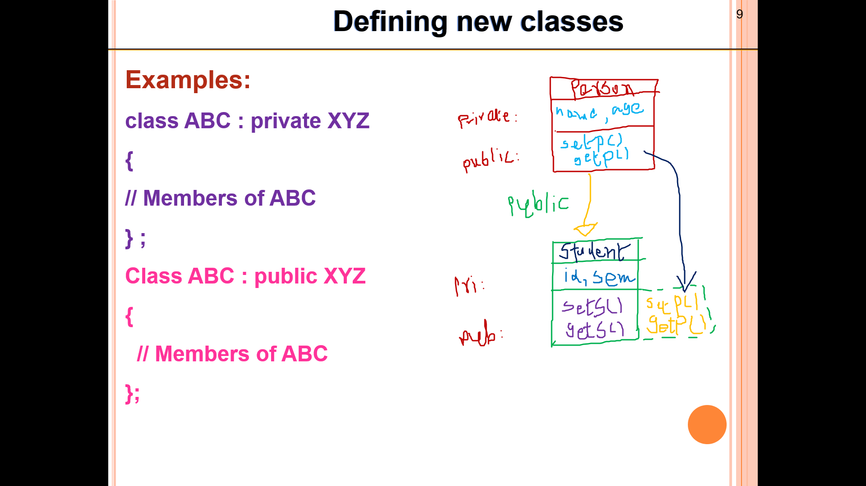
1. Single Level Inheritance

Slide 11
Deriving a base class publicly
When a base class is publicly inherited by a derived class, public members of a base class become public members of derived class therefore they are accessible by the objects of derived class.

Slide 12
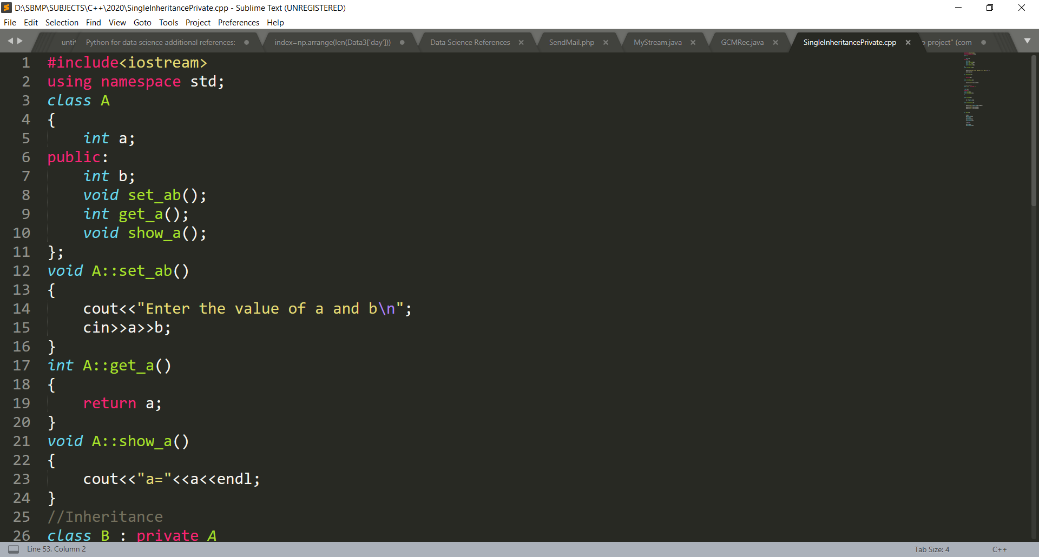
Deriving a base class publicly

Slide 13
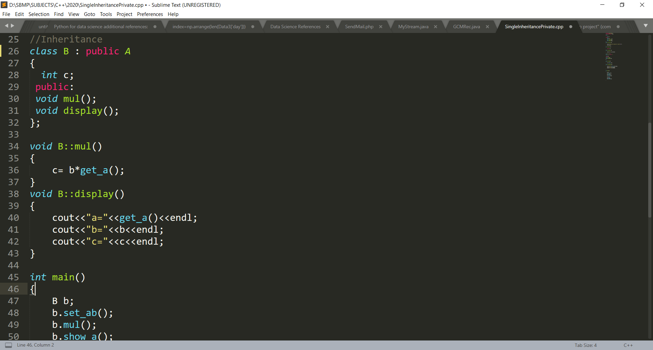
Deriving a base class publicly

Slide 14
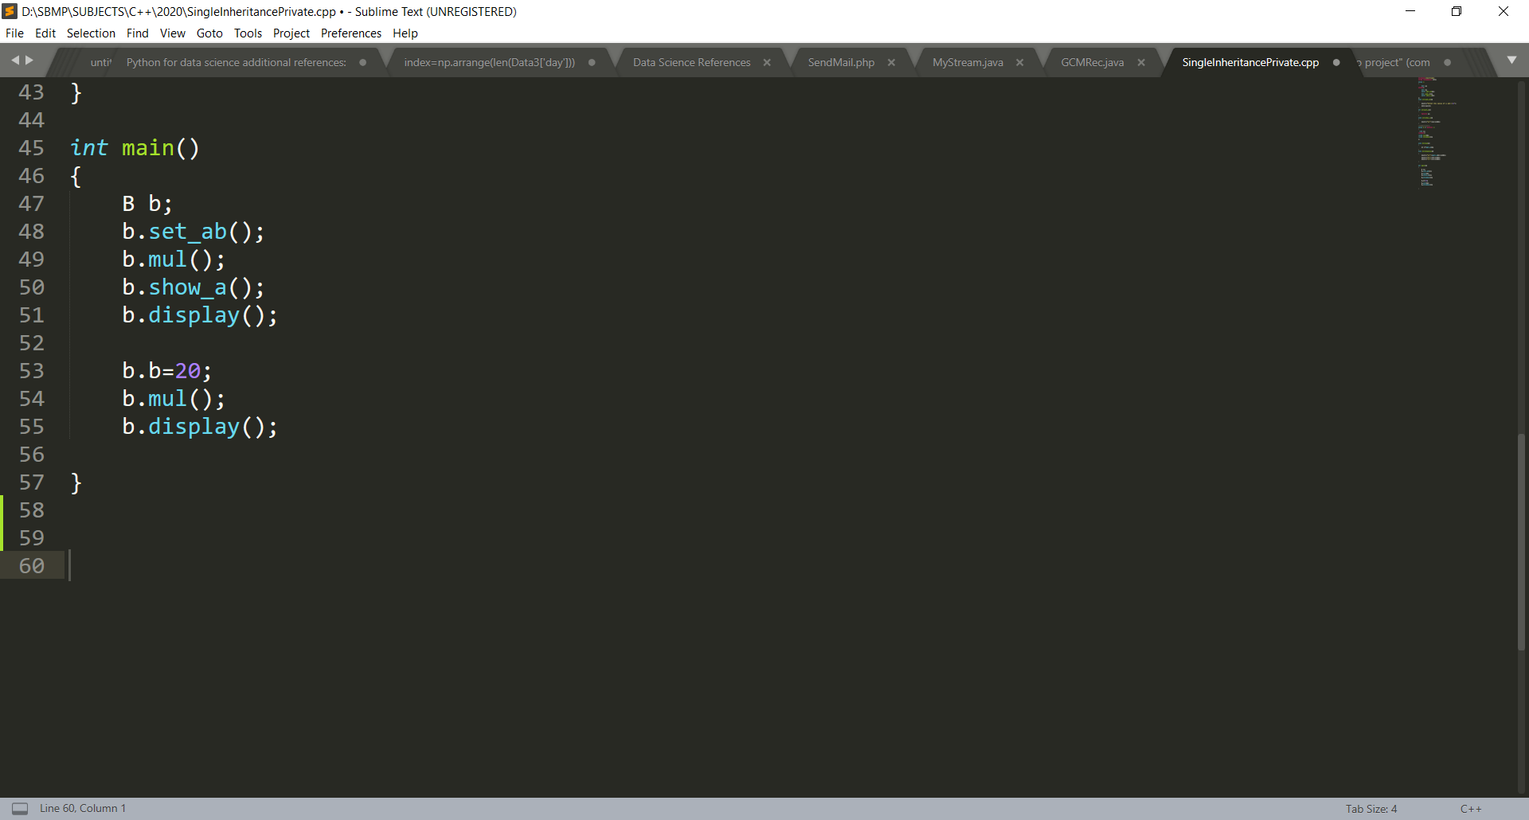
Deriving a base class publicly

Slide 15

Deriving a base class publicly

Slide 16
Deriving a base class privately
When a base class is privately inherited by a derived class, public members of a base class become private members of derived class therefore public members of a base class can only be accessed by the public members of the derived class. (They are inaccessible by the objects of derived class)

Slide 17
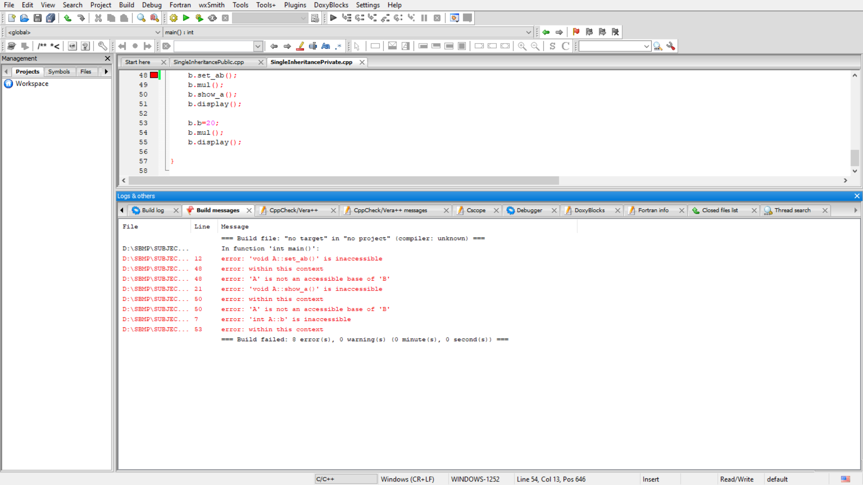
Deriving a base class privately

Slide 18
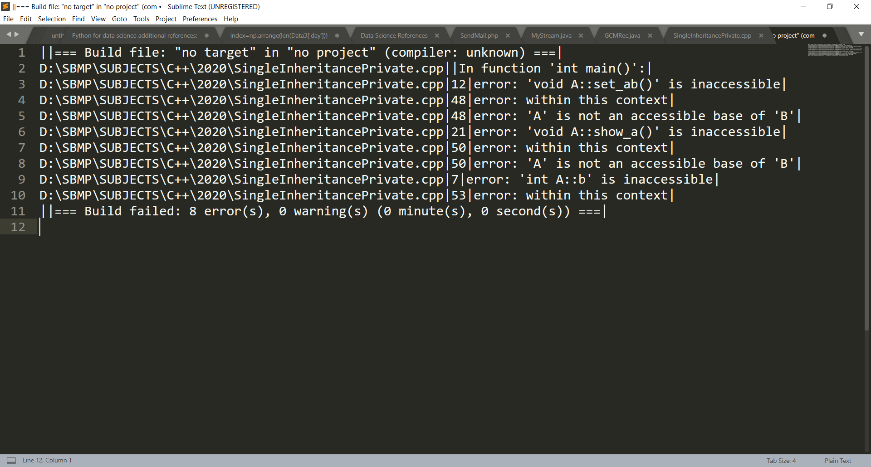
Deriving a base class privately

Slide 19
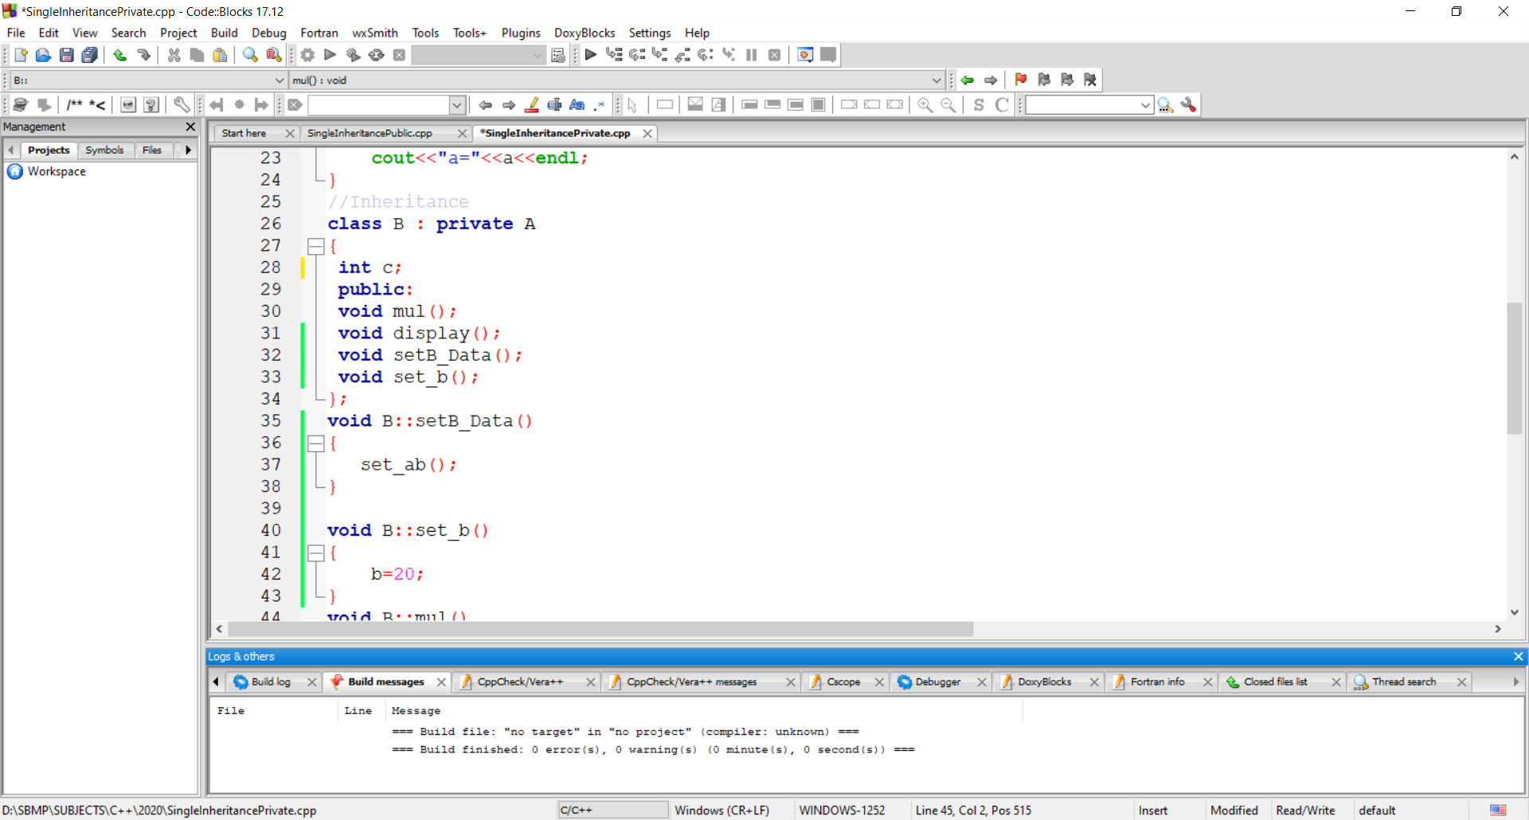
Deriving a base class privately

Slide 20
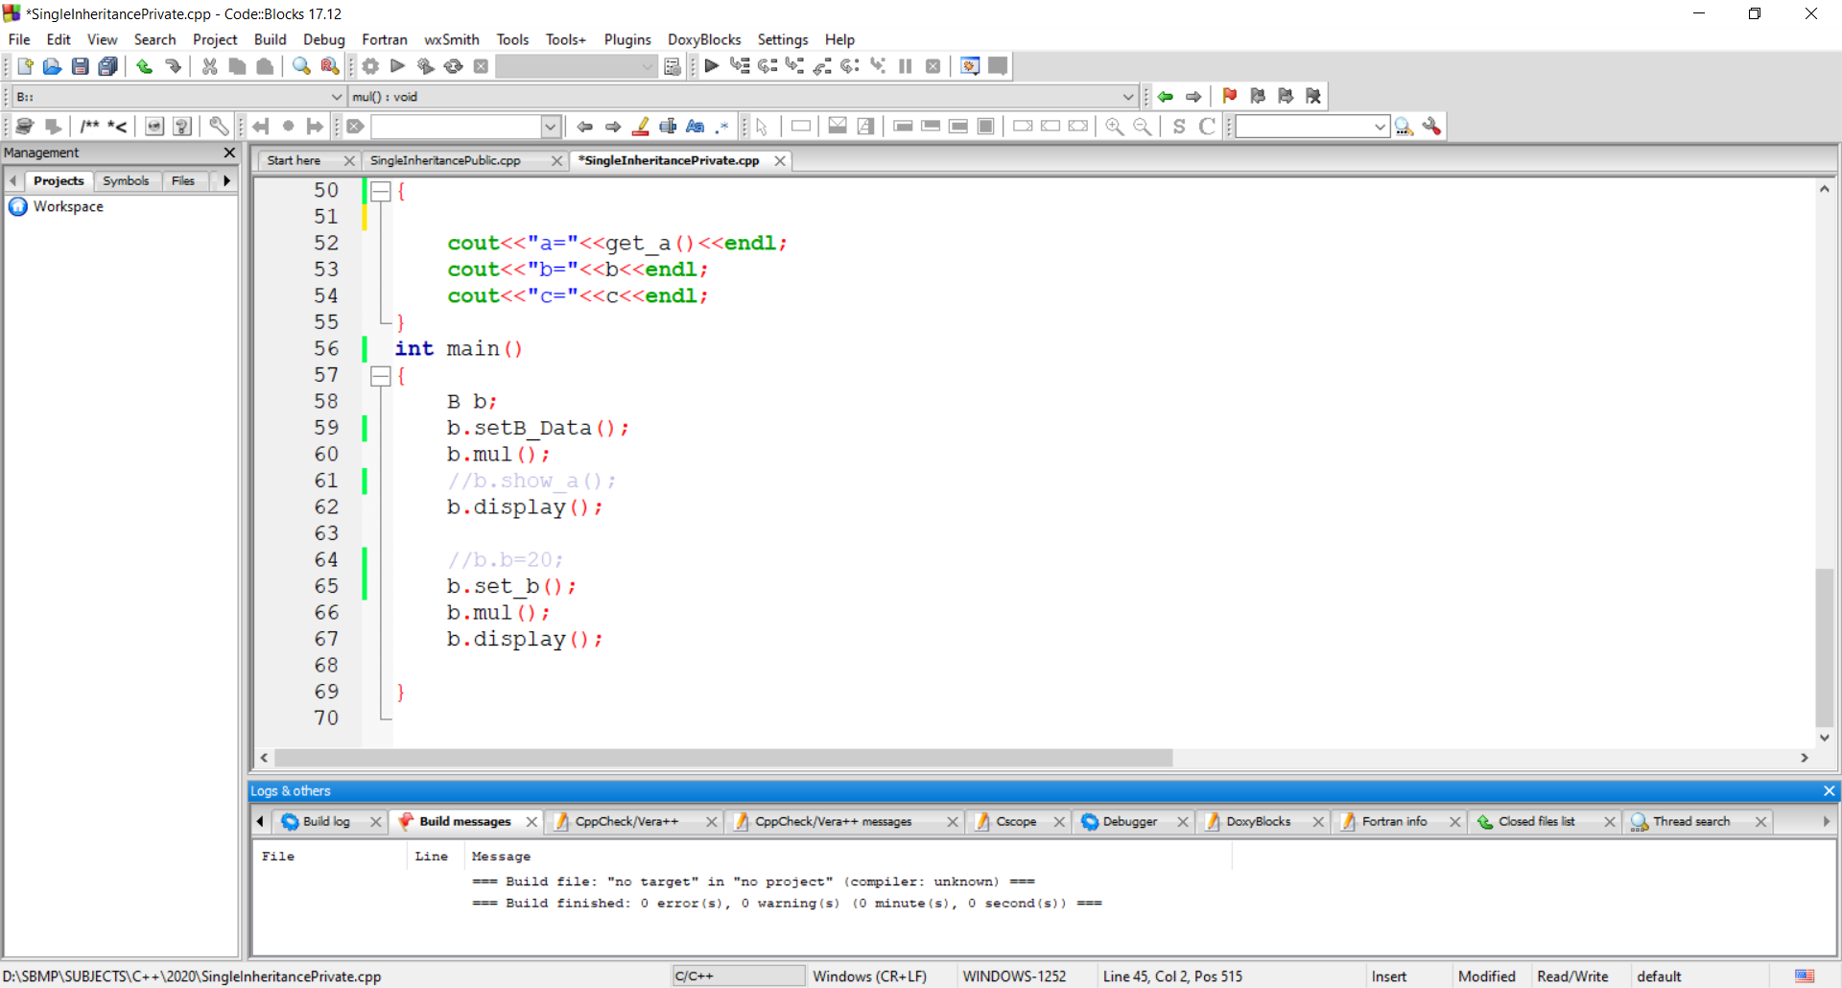
Deriving a base class privately

Slide 21
Deriving a base class
In both cases private members are not inherited( private members of base class will never become the member of derived class).

Slide 22
Single Inheritance Examples
Q:1 class Student inherits class Person
Q:2 class Test inherits class Student

Slide 23
Making a private member Inheritable

Slide 24
protected access modifier
The data with private modifier is not inherited at all. At the other side the data with public modifier is accessible to all other functions of the program.
A member declared as protected is accessible by the member functions within its class and any class immediately derived from it.
It can not be accessed outside these 2 classes.

Slide 25
protected access modifier
It is also possible to inherit a base class in protected mode. (protected derivation)
In protected derivation, both the public and protected members of the base class become protected members of the derived class.

Slide 26
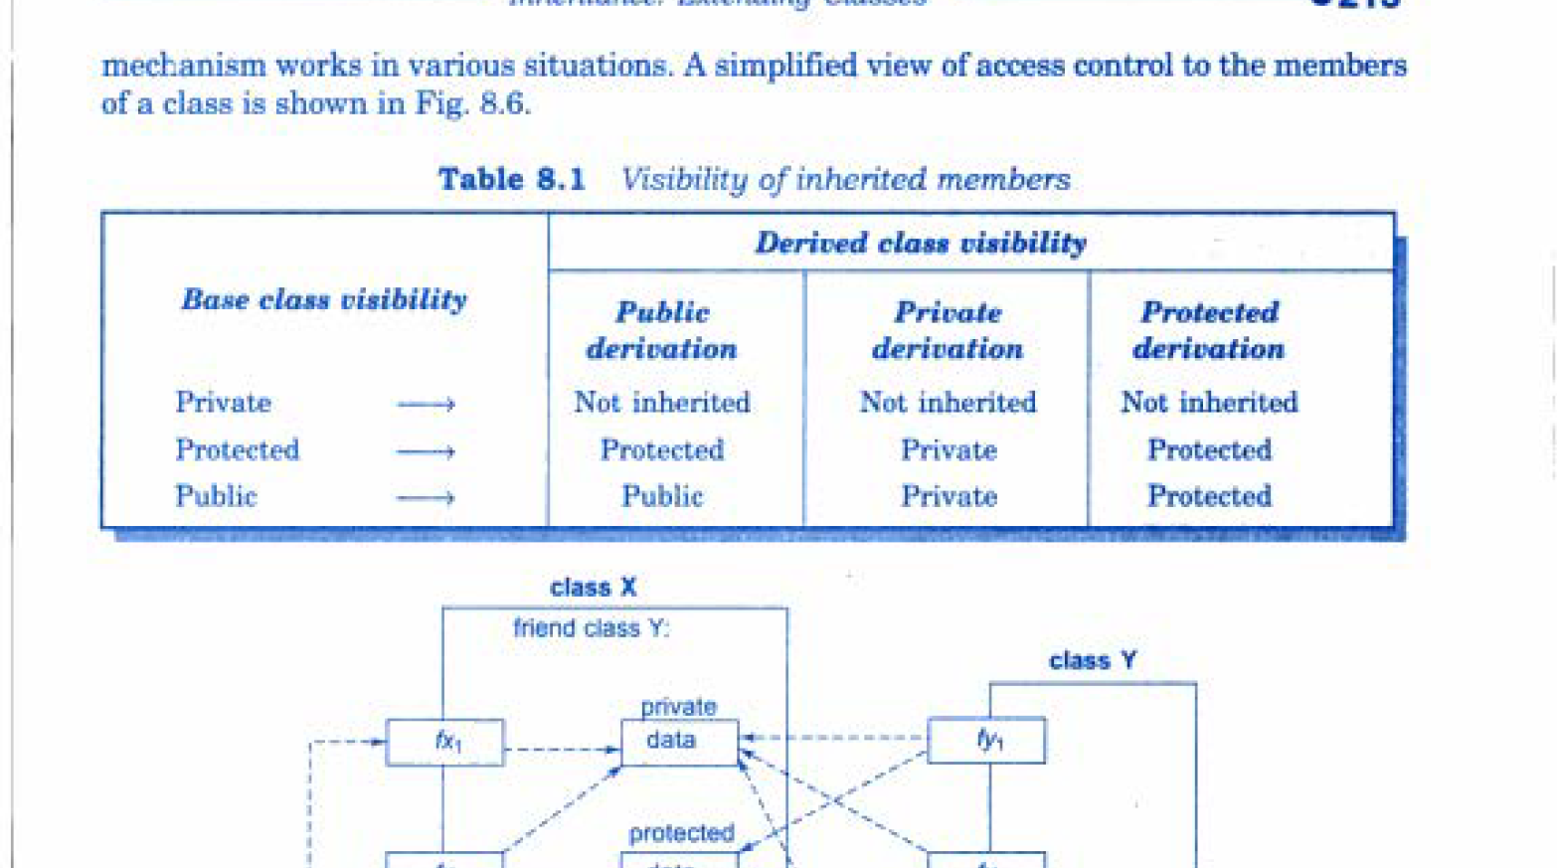
Access Modifier Table

Slide 27
2. Multi Level Inheritance

Slide 28
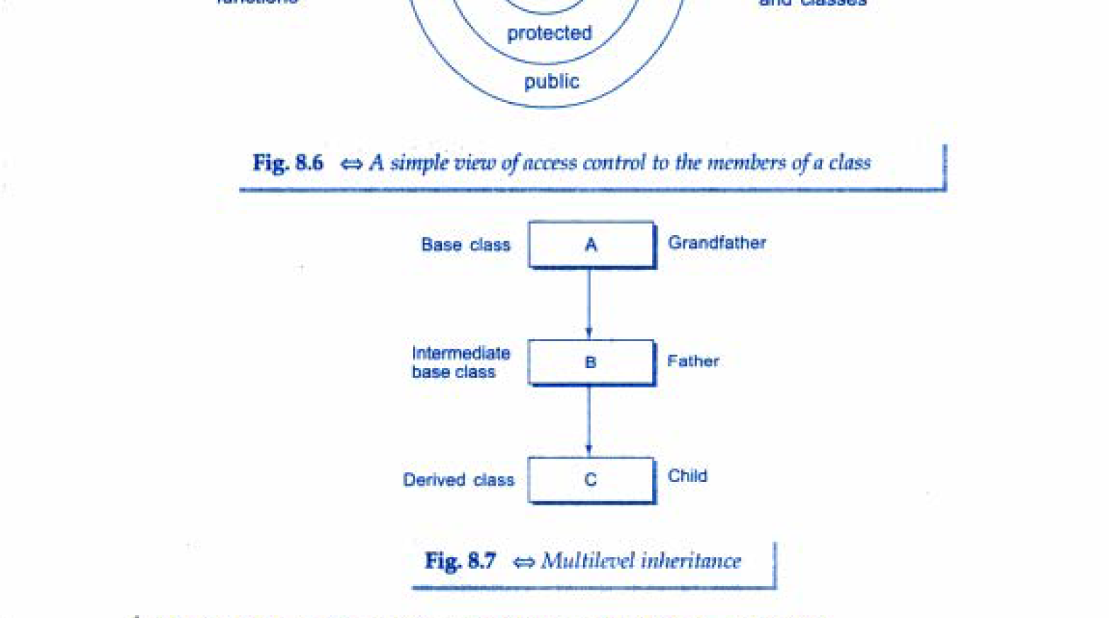
Multi Level Inheritance
One class is inherited by another class which in turn also inherited by another class and so on…

Slide 29
Multi Level Inheritance
Student
Test
Result

Slide 30
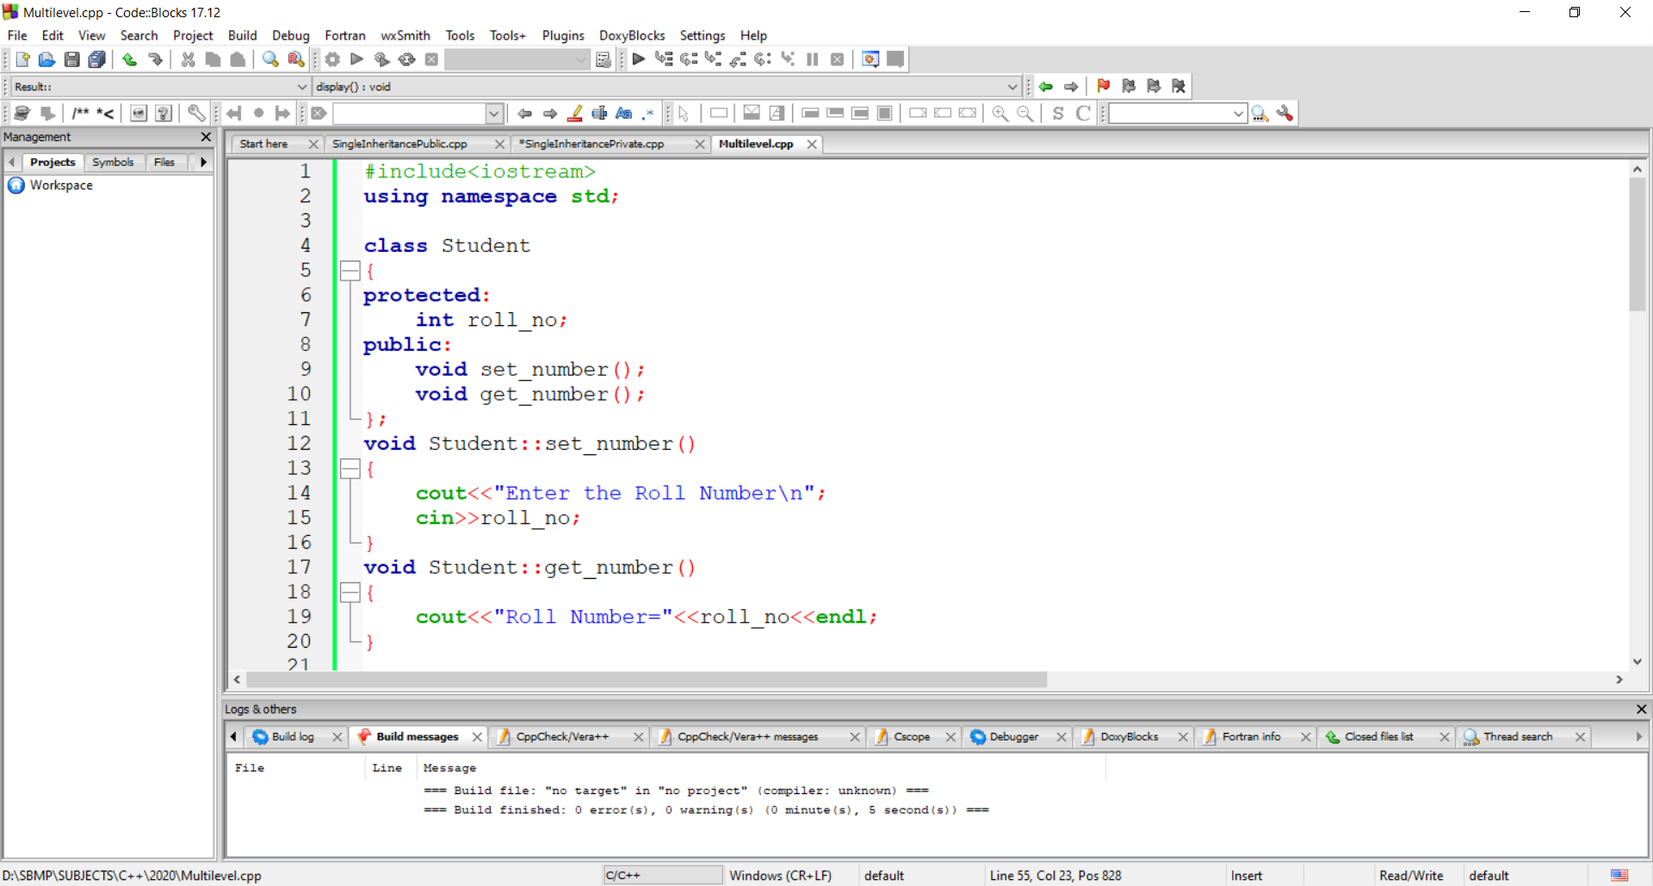
Multi Level Inheritance

Slide 31
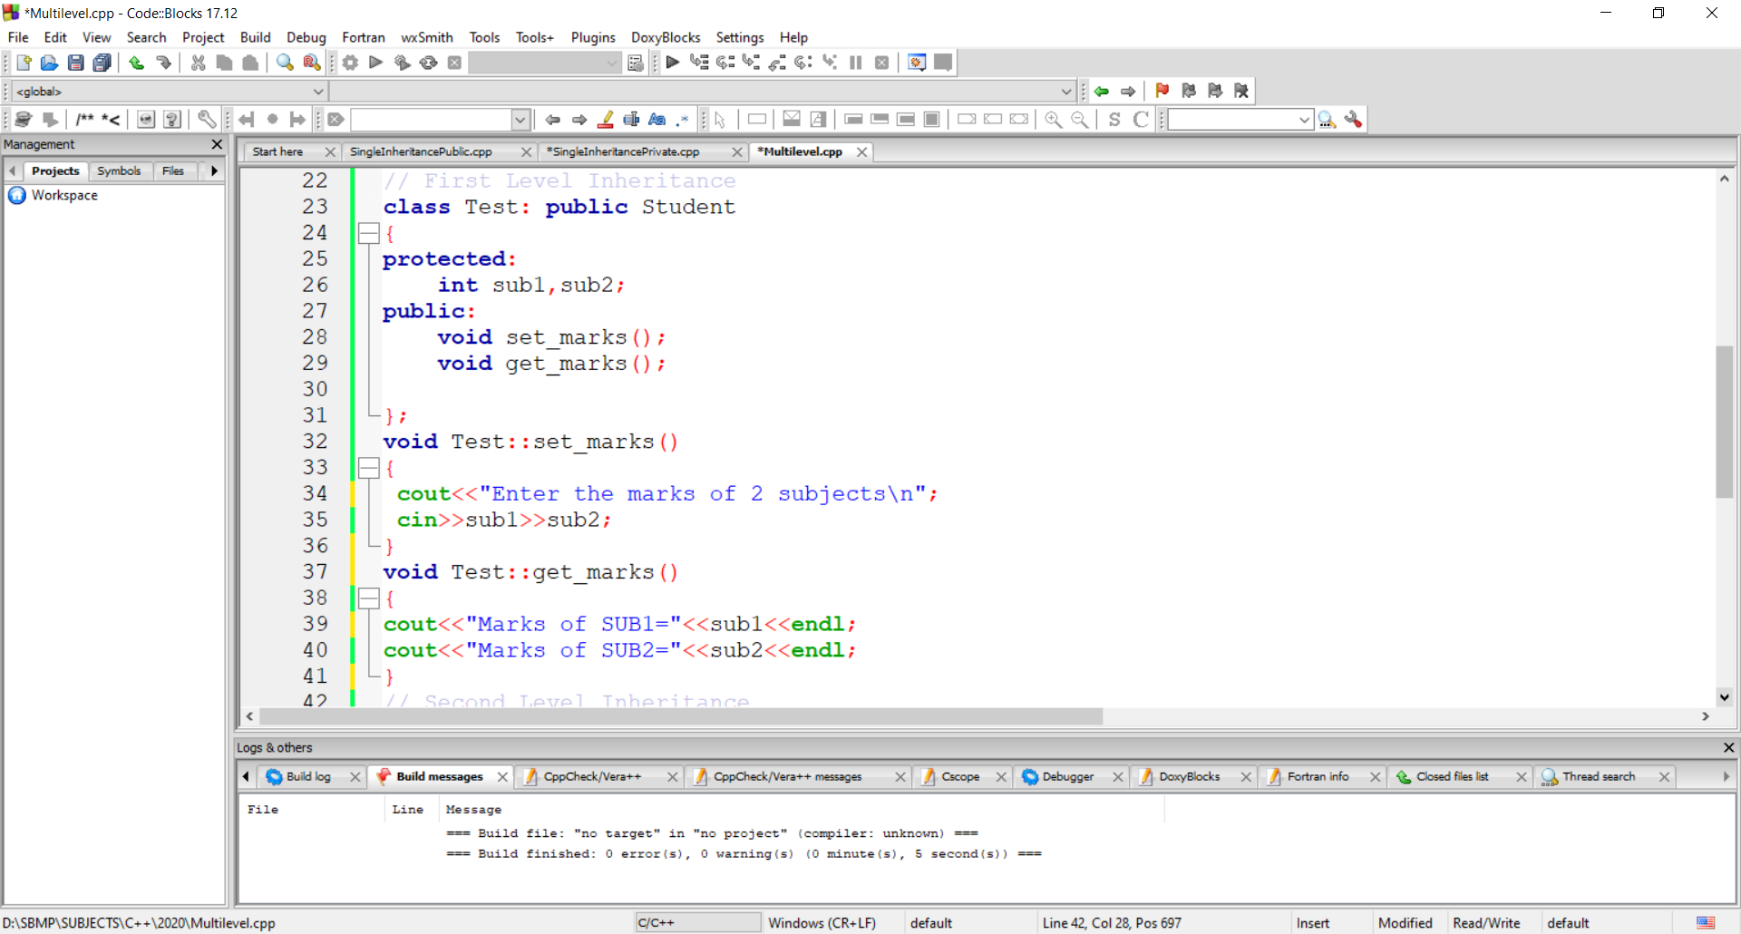
Multi Level Inheritance

Slide 32
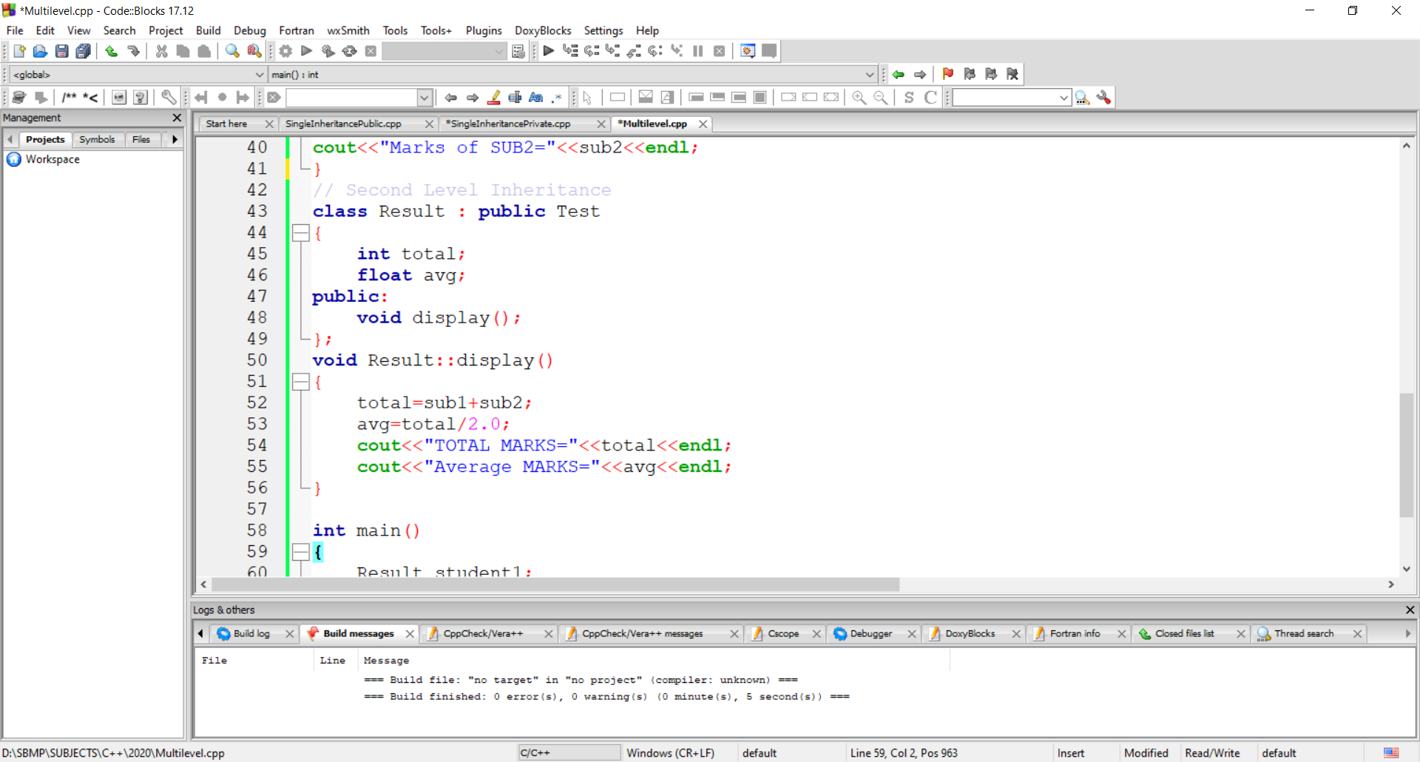
Multi Level Inheritance

Slide 33
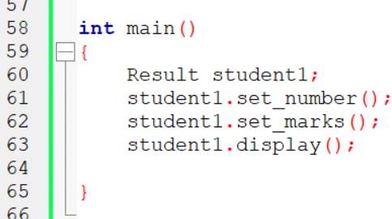
Multi Level Inheritance

Slide 34

Multi Level Inheritance

Slide 35
3. Hierarchical Inheritance

Slide 36
Hierarchical Inheritance
Many programming problems can be represented into hierarchy where certain features of one level are shared by many others as shown in the figures:
Person
Student
Faculty

Slide 37
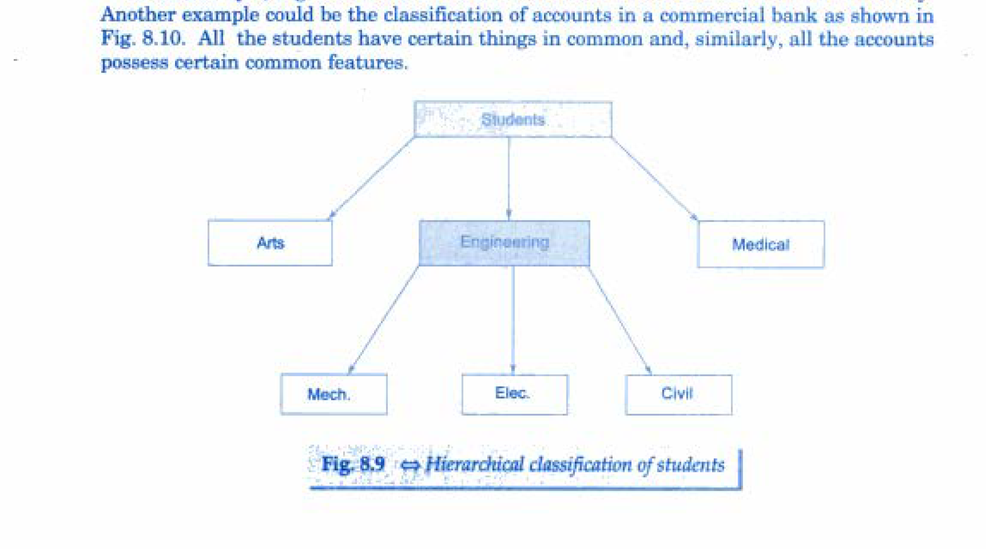
Hierarchical Inheritance

Slide 38
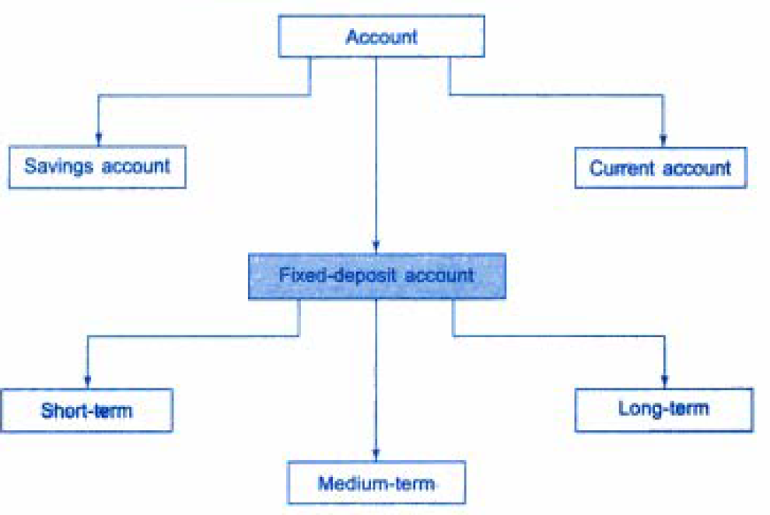
Hierarchical Inheritance

Slide 39
4. Multiple inheritance

Slide 40
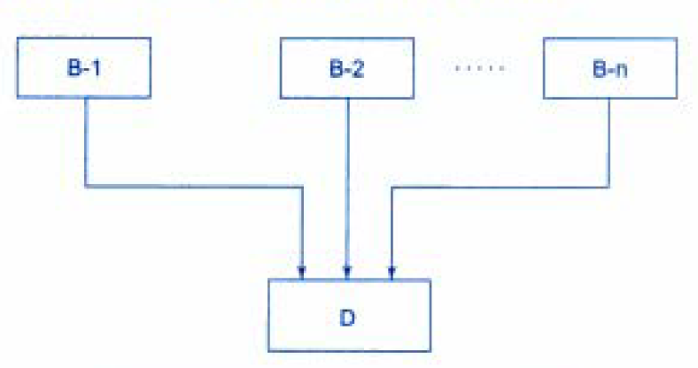
Multiple Inheritance
A class can inherit the attributes of more than one classes, is known as Multiple Inheritance.
It allows us to combine the features of several existing classes into the derived (child) class.

Slide 41
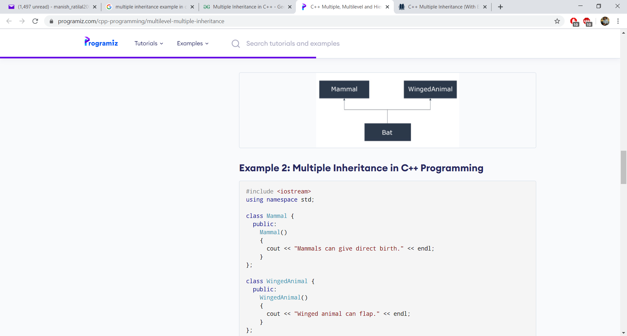
Multiple Inheritance
Syntax:
class D : visibility B-1, visibility B-2, …
{
// Body of class D
};

Slide 42
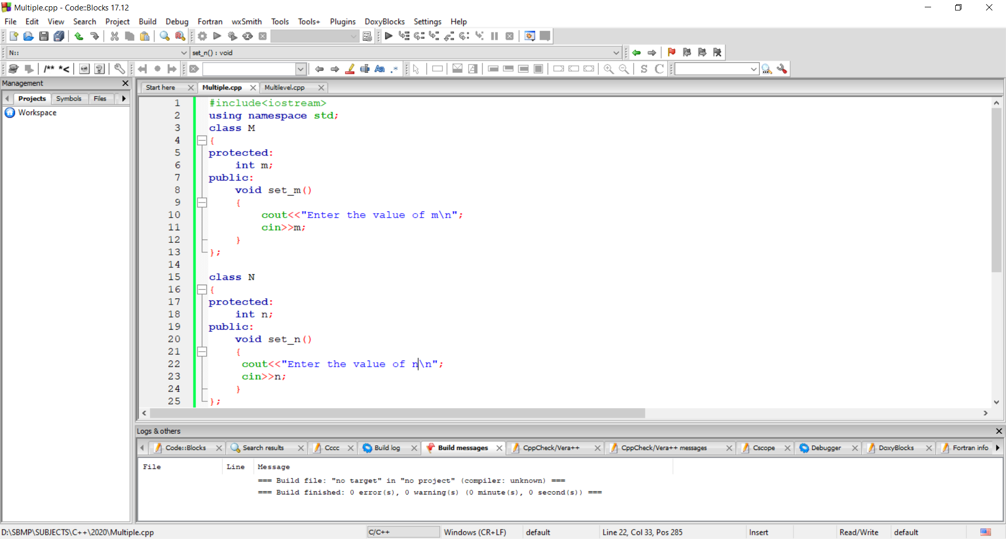
Multiple Inheritance
Example:

Slide 43
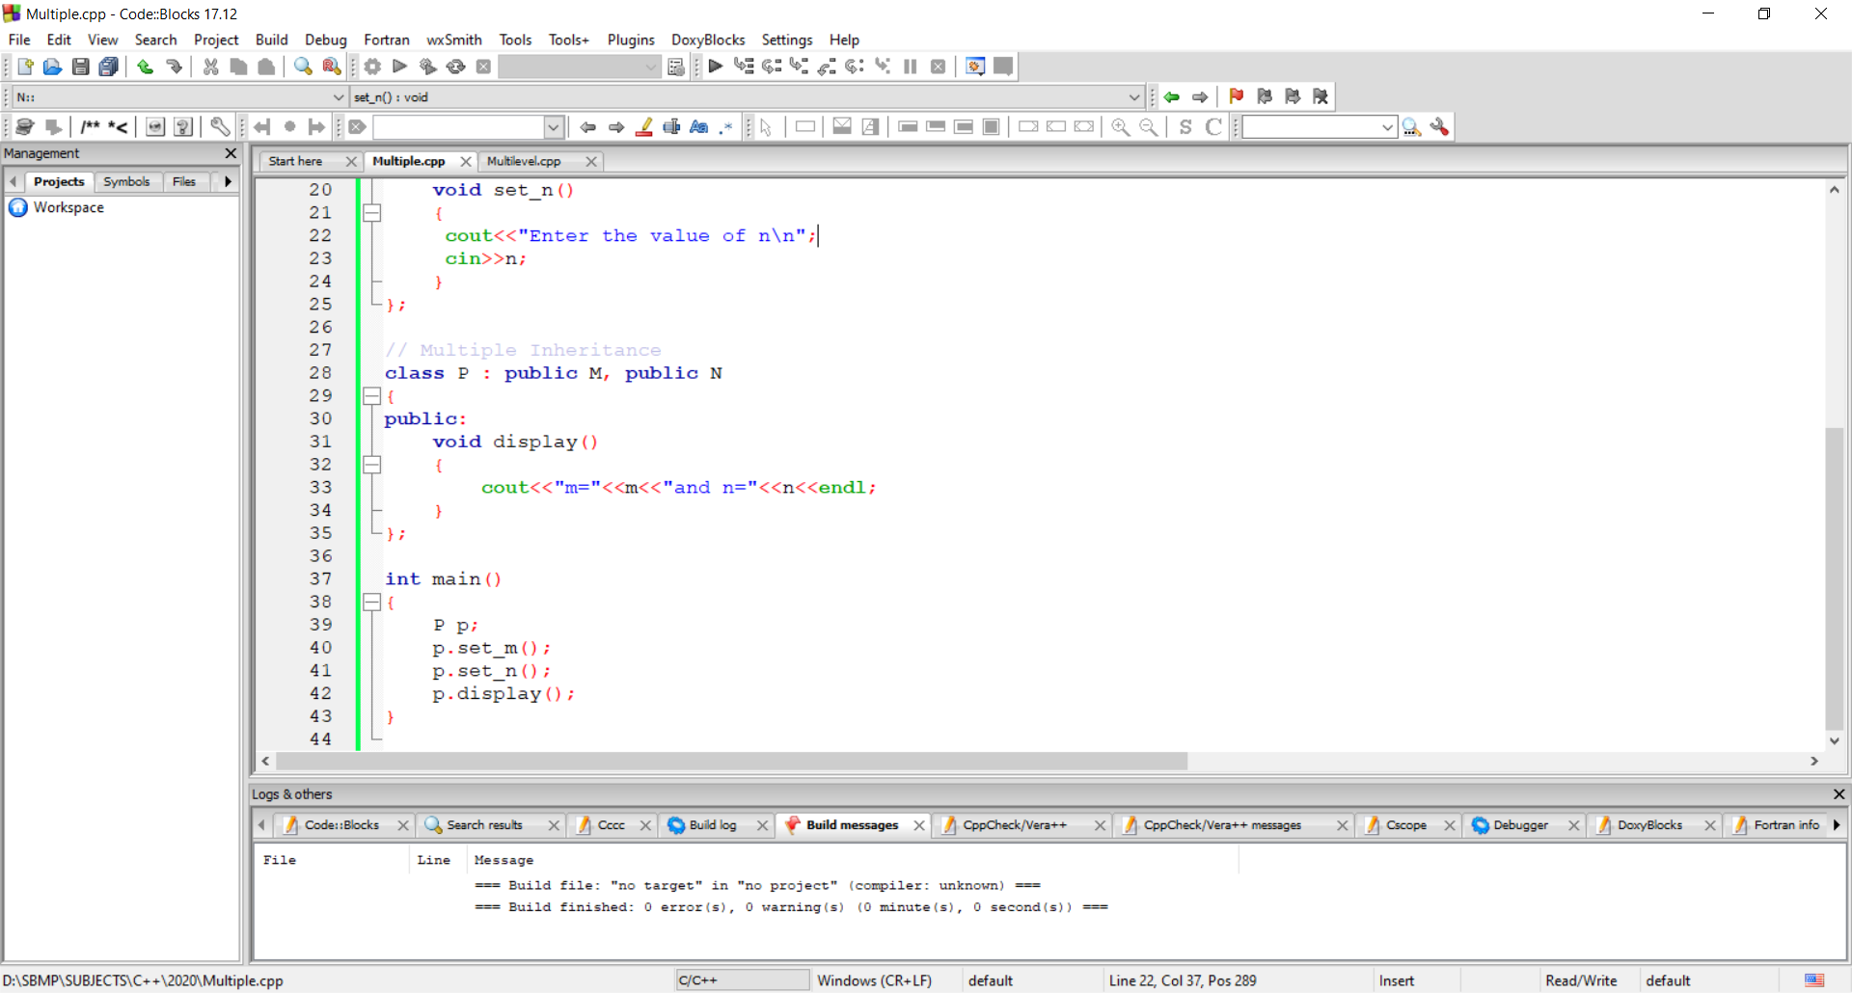
Multiple Inheritance
Example:

Slide 44
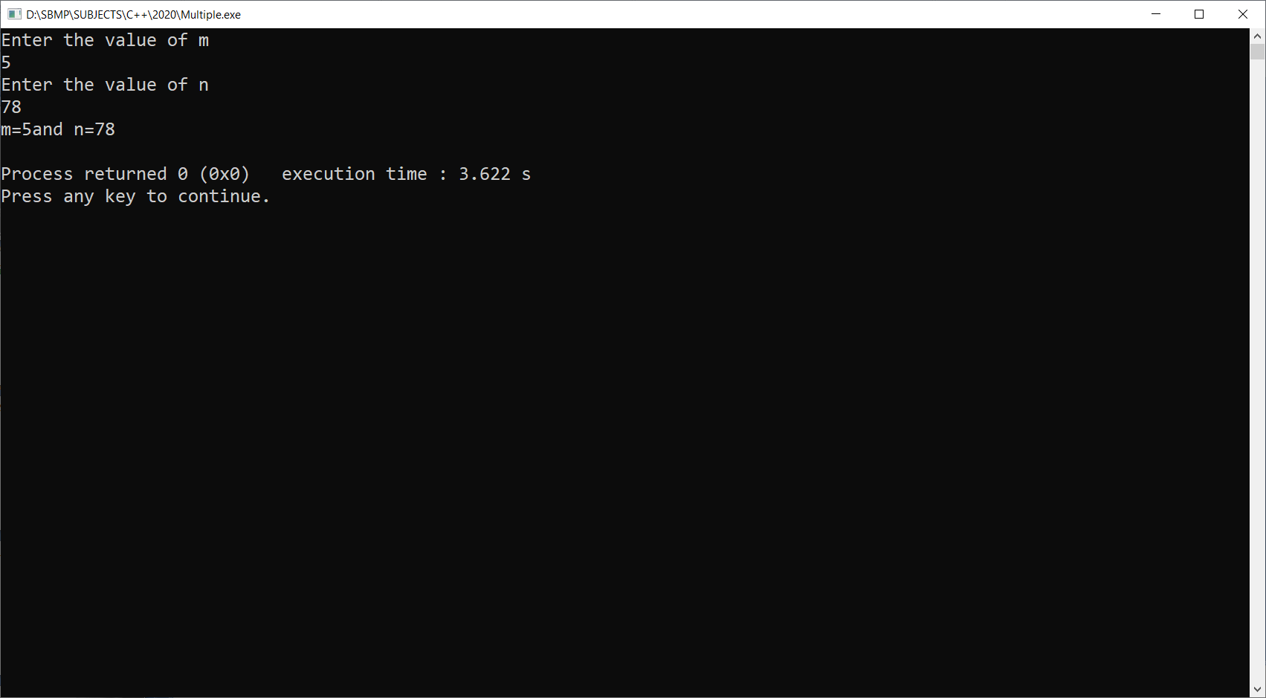
Multiple Inheritance
Example:

Slide 45
Multiple Inheritance
Example:

Slide 46
Ambiguity in Inheritance

Slide 47
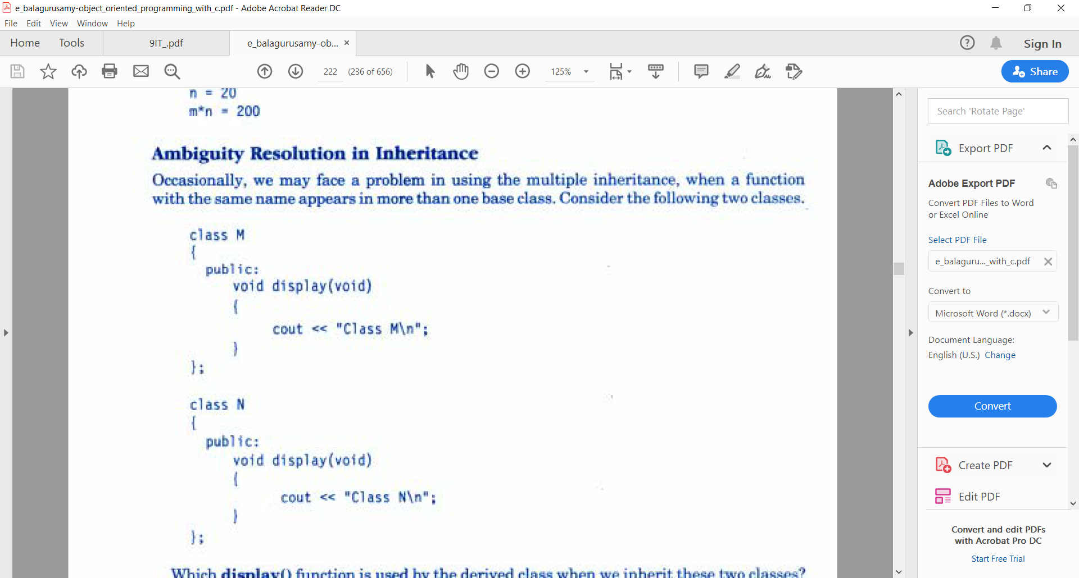
Ambiguity In Multiple Inheritance
If we define the same function in both the base classes i.e. M and N then class P will have confusion to call the appropriate function

Slide 48
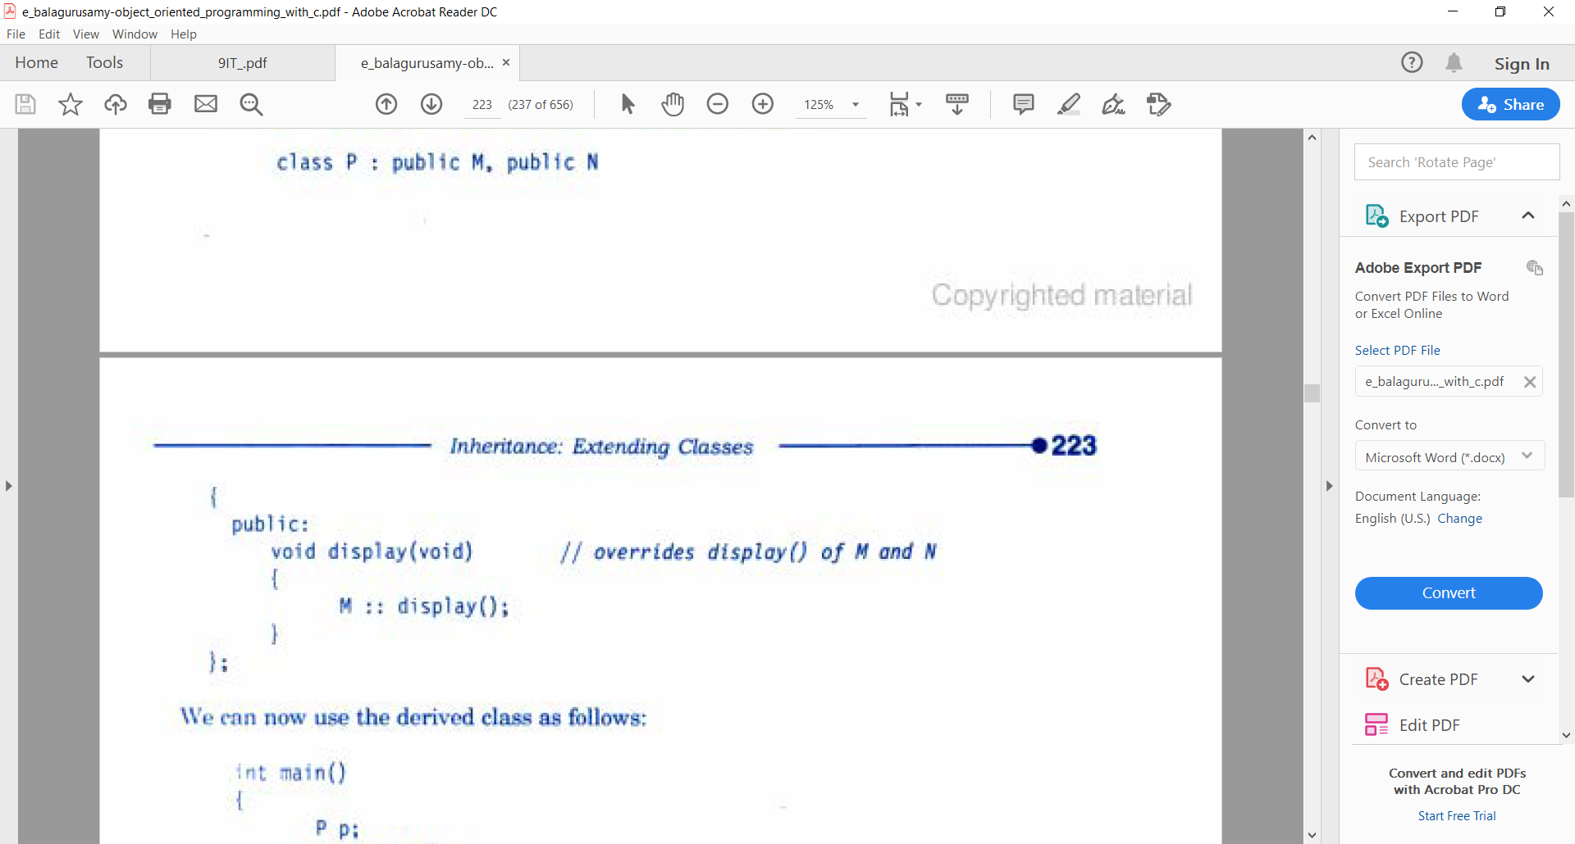
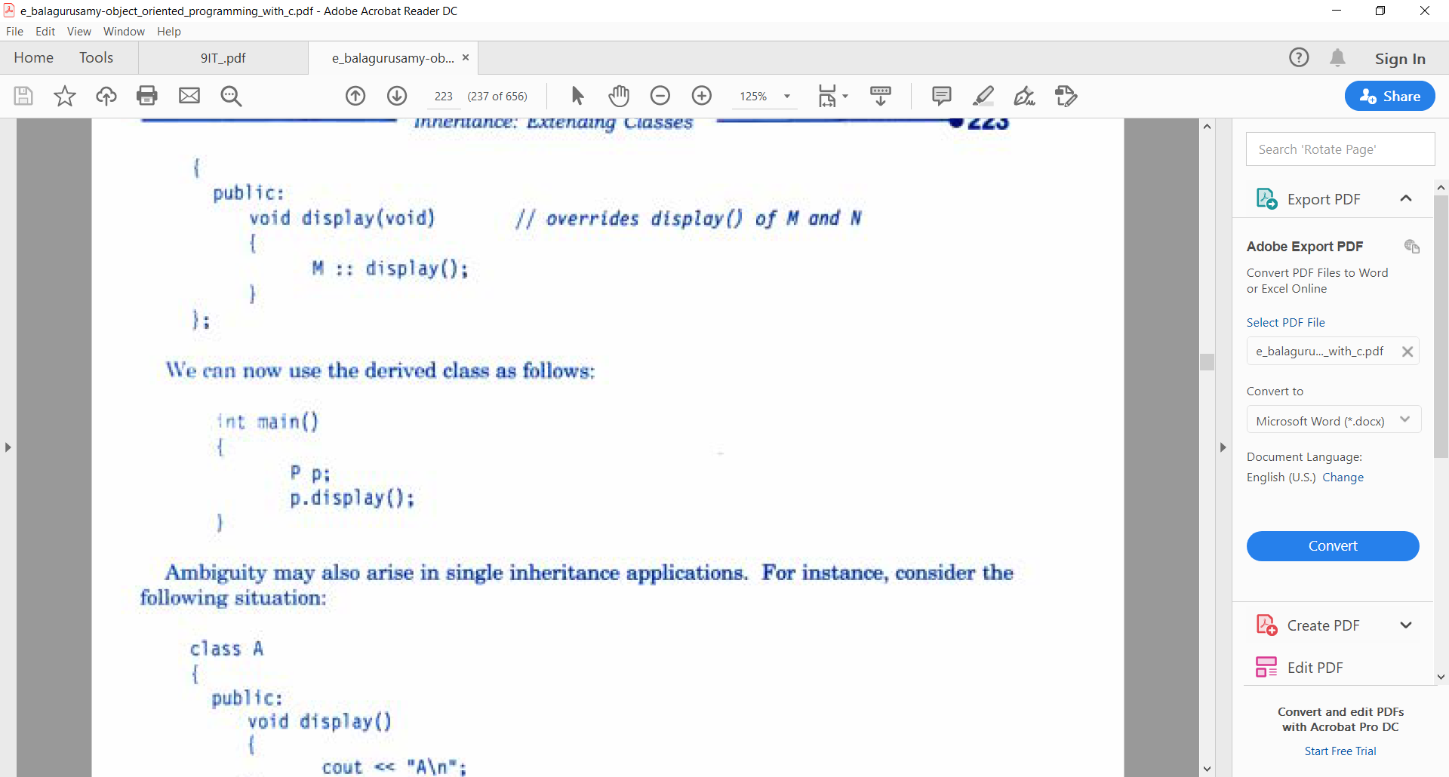
Ambiguity In Multiple Inheritance
Solution: We should call the display function with class name i.e. M/N and :: as shown below:

Slide 49
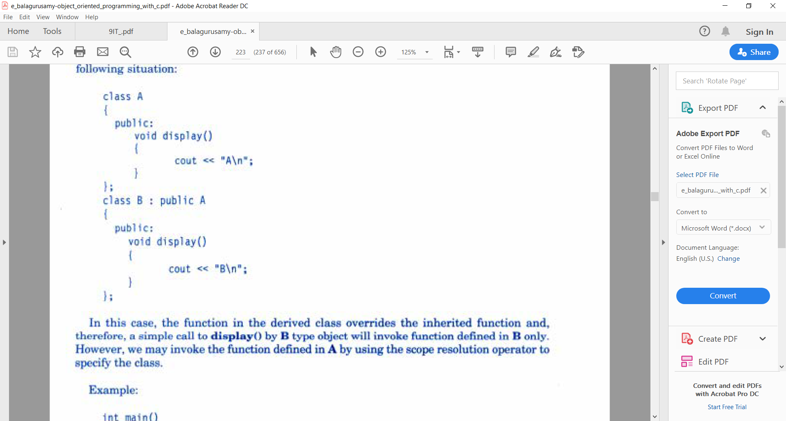
Ambiguity In Single Inheritance
Both base and derived class have defined the same function as shown in the example:

Slide 50
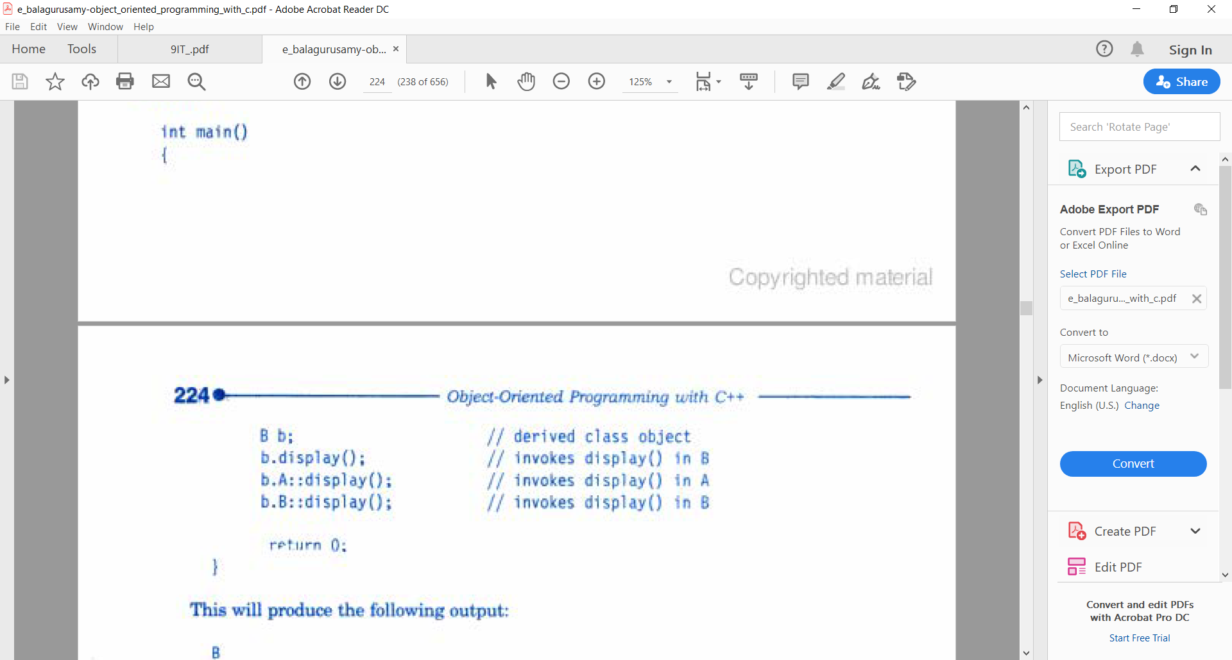
Ambiguity In Single Inheritance
Solution: Inside main() call the function with class name and ::

Slide 51
5. Hybrid Inheritance

Slide 52
4. Hybrid Inheritance

Slide 53
Multiple Inheritance
In this case combination of more than one type of Inheritance is used.
Student
Test
Sports
Result

Slide 54
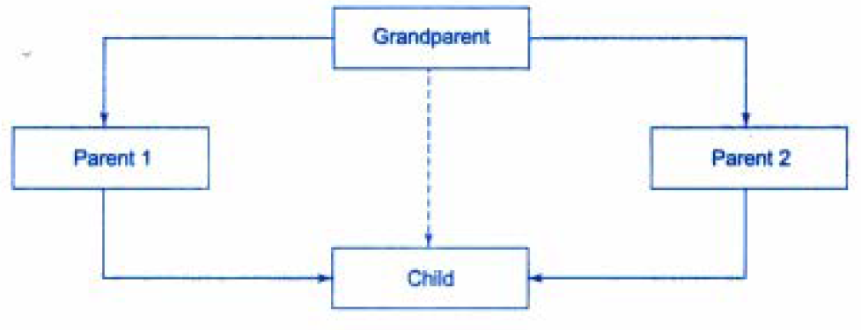
virtual base class
If we combine 3 types of inheritance as shown in the figure:
Here, child has two parents(multiple) and parent 1 and parent 2 are derived from Grandparent (hierarchical). The child inherits Grandparent by two separate paths(multilevel)

Slide 55
virtual base class
All the protected and public qualities of Grandparent are inherited twice in the child through parent1 and parent2.
This introduces duplication and thus ambiguity which should be avoided.
This ambiguity is avoided by making common base class(ancestor) as virtual base class using the keyword virtual.

Slide 56
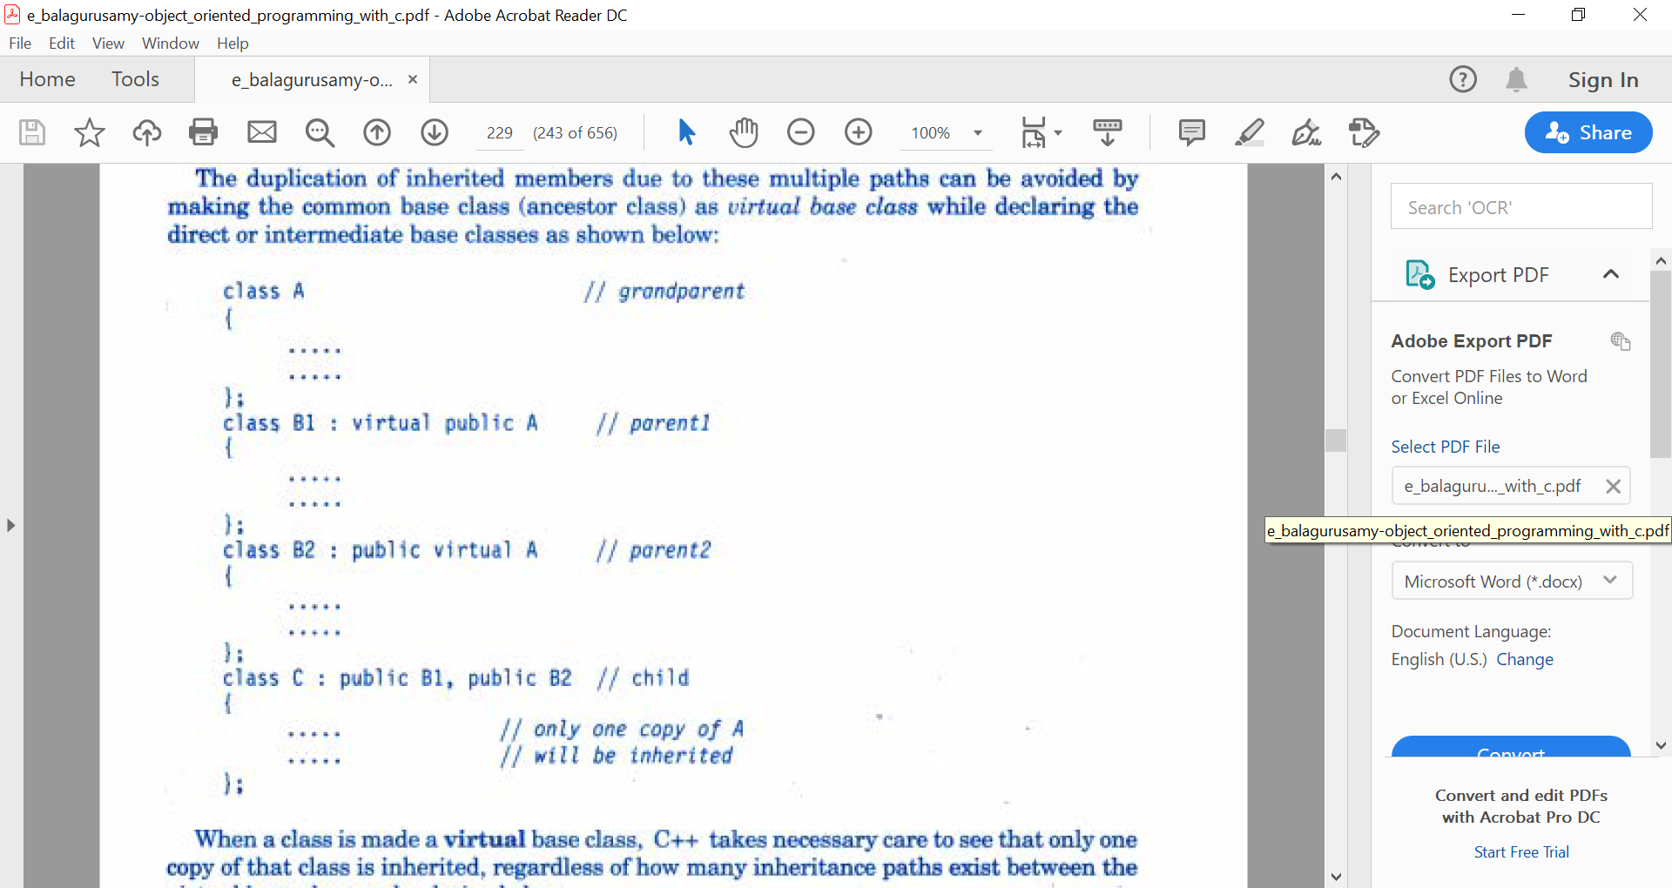
virtual base class

Slide 57
virtual base class
When a class is made a virtual base class, only one copy of this class is inherited regardless of paths existing between base and derived class.

Slide 58
virtual base class
Student
Test
Sports
Result

Slide 59
Abstract class
An abstract class is designed only to act as a base class.
This class is inherited by its derived class.
We do not create objects of an abstract class.
Example: Student class is acting as an abstract class.

Slide 60
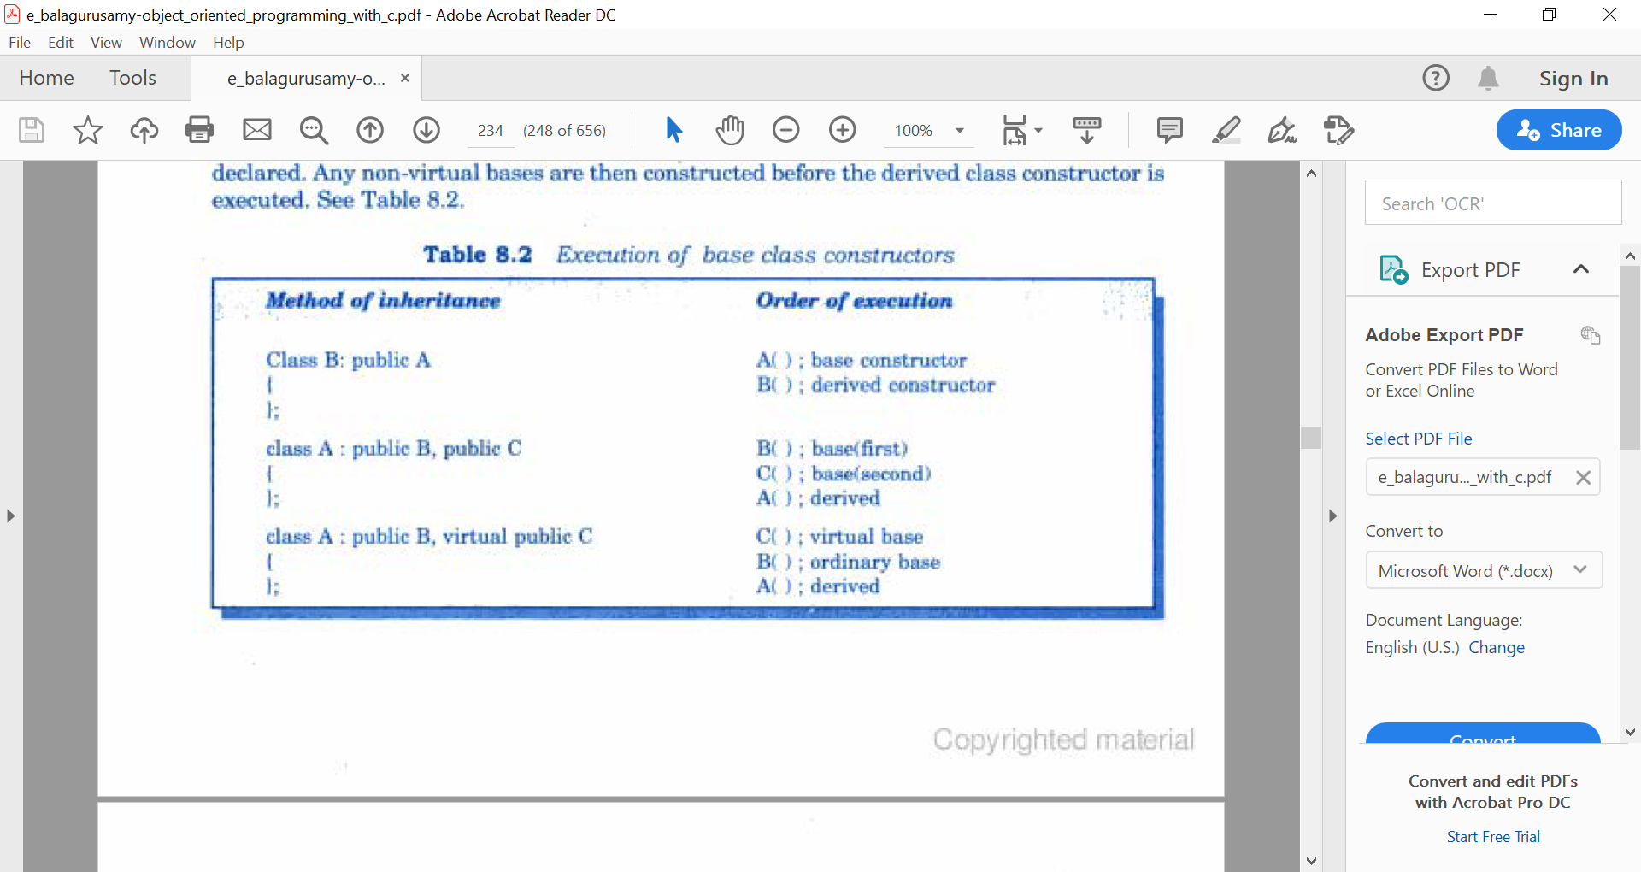
Constructor call in Inheritance
Constructors in Inheritance are invoked in the order of Inheritance i.e. at first parent class then child then grandson and so on….

Slide 61
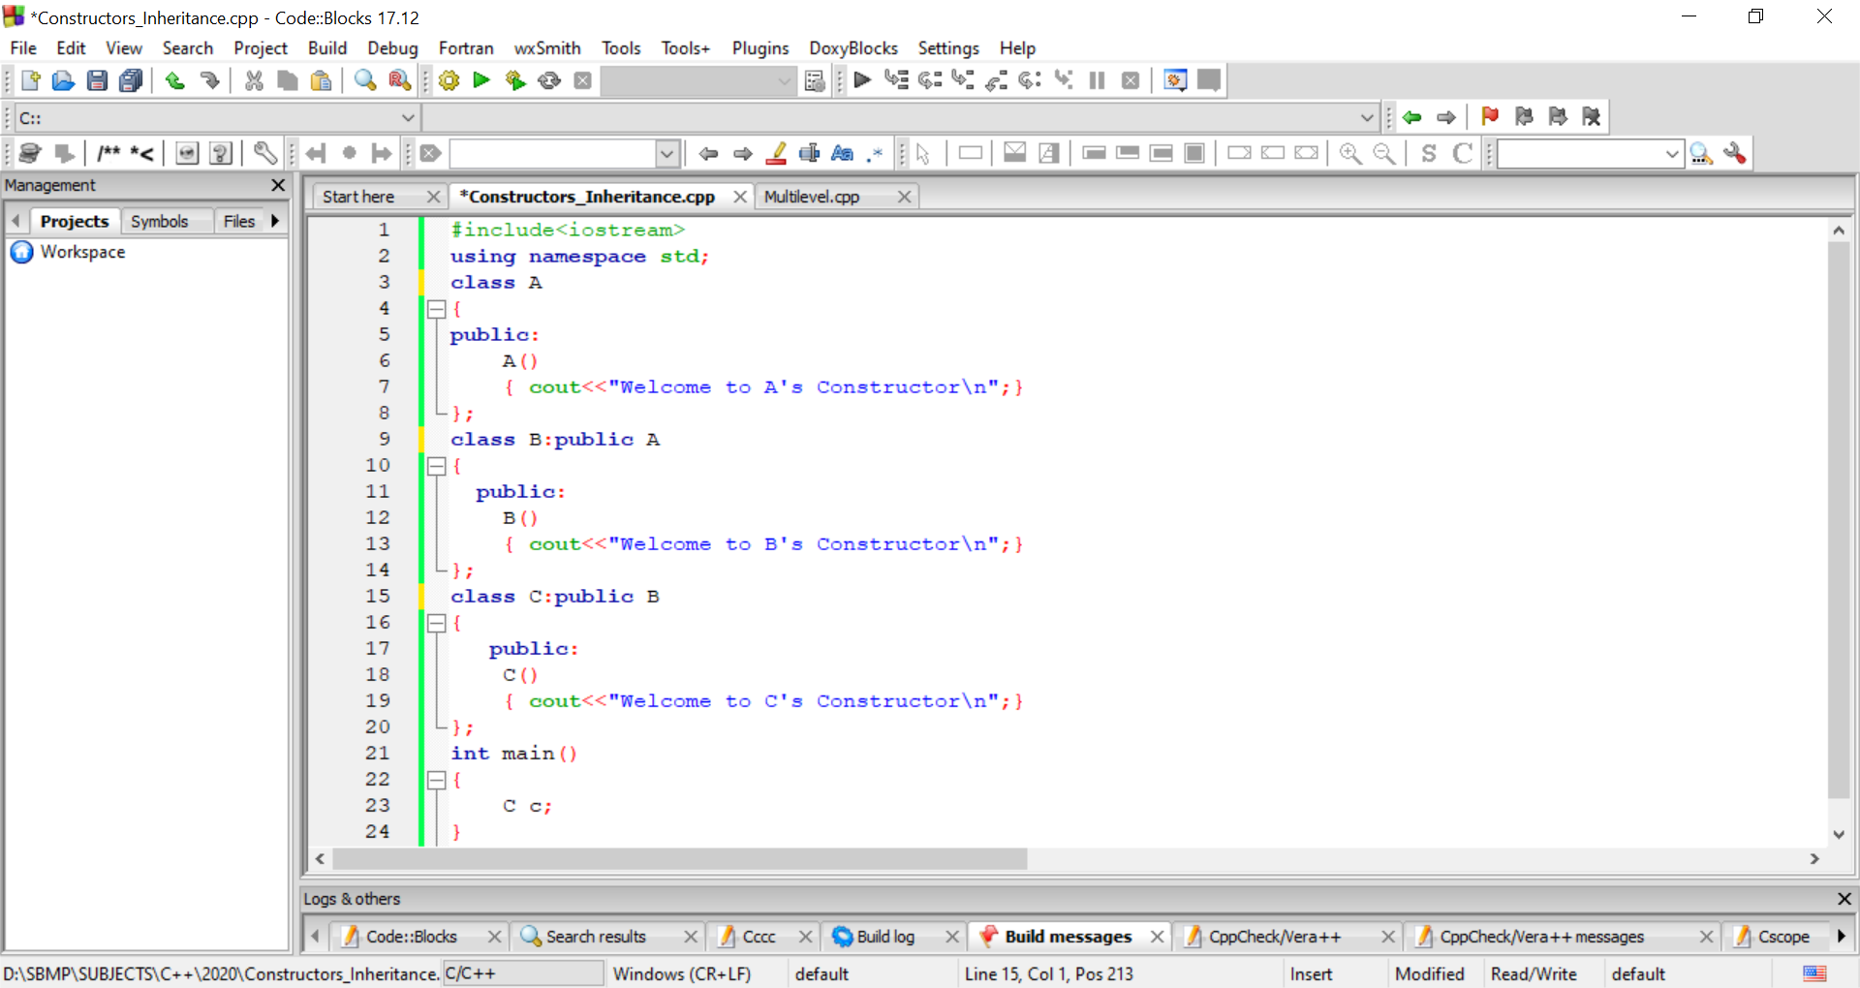
Constructor call in Inheritance

Slide 62
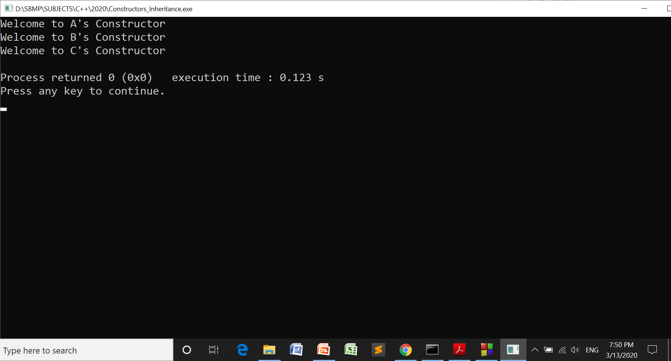
Constructor call in Inheritance

Slide 63
Passing arguments to constructors
Derived class constructor takes all the parameters of its base class.
The base class does the same for its base class..
Syntax: Multilevel Inheritance
derived_constructor(arg1,arg2,….argn) :
base(arg1,arg2,…argn-1)
{
// use argn
}
Note: Last arguments are for the derived class

Slide 64
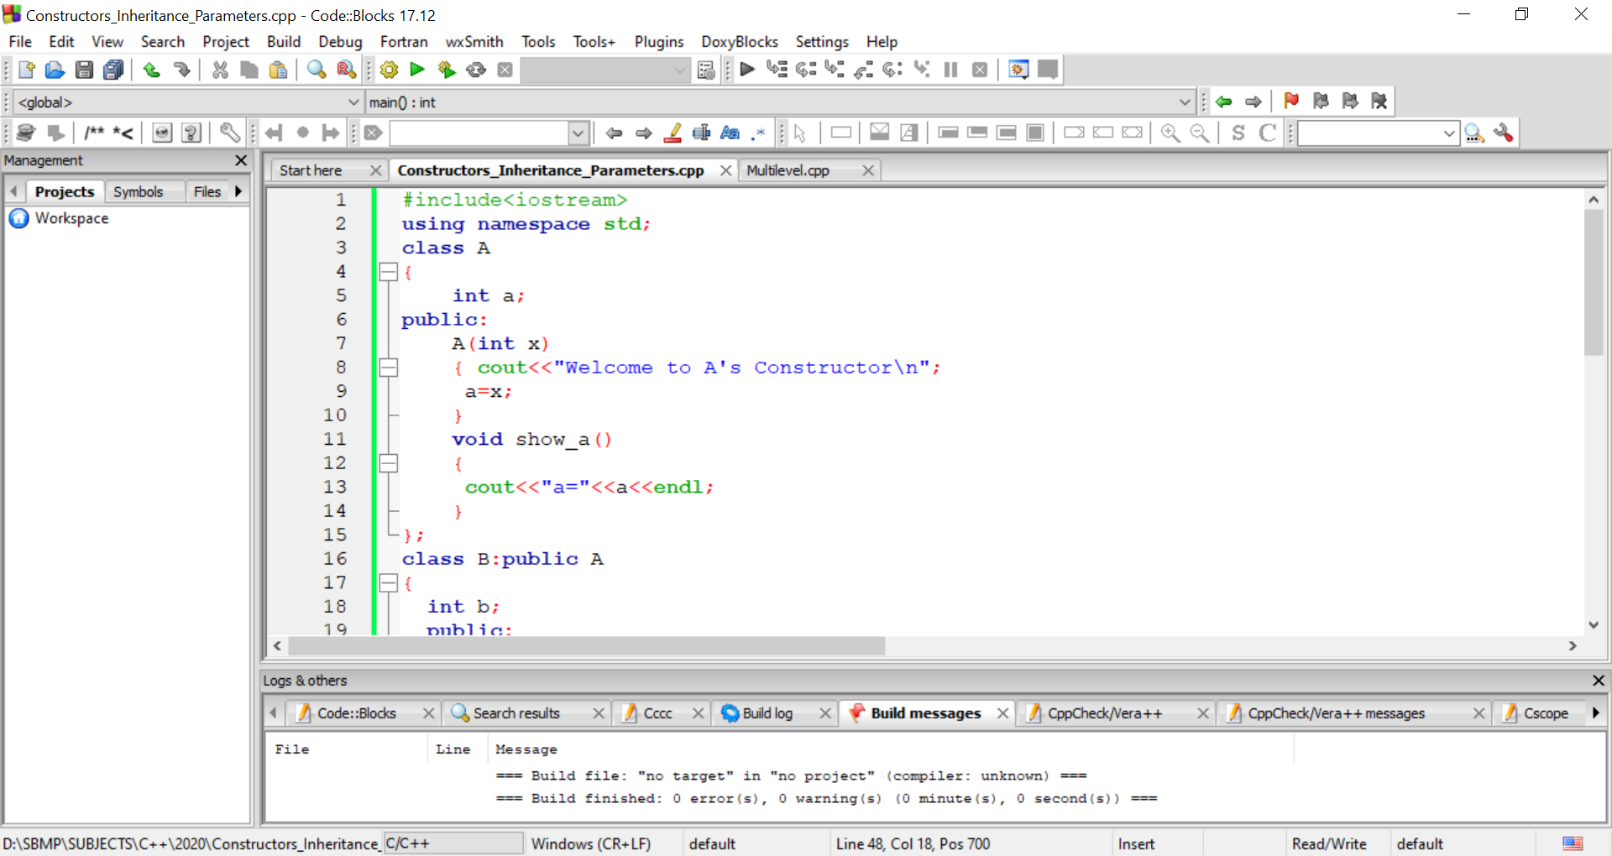
Passing arguments to constructors

Slide 65
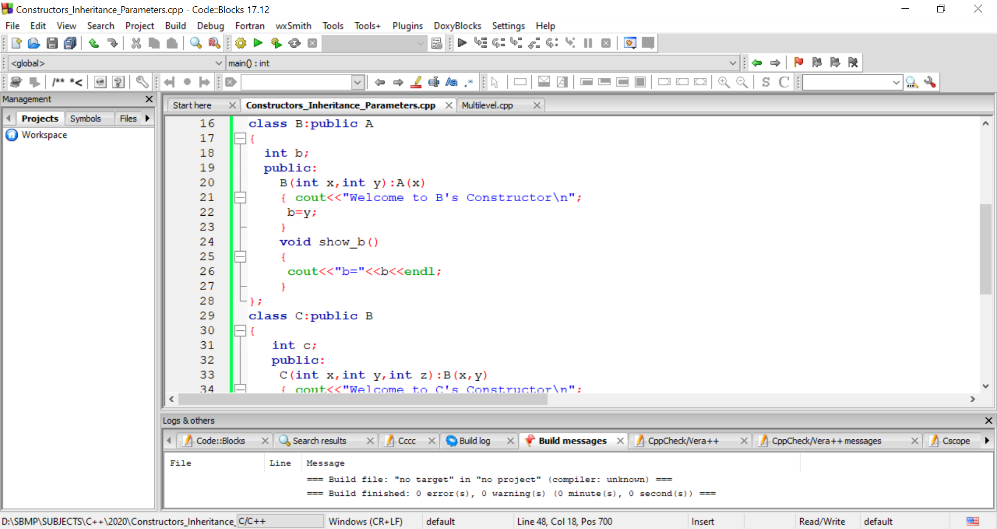
Passing arguments to constructors

Slide 66
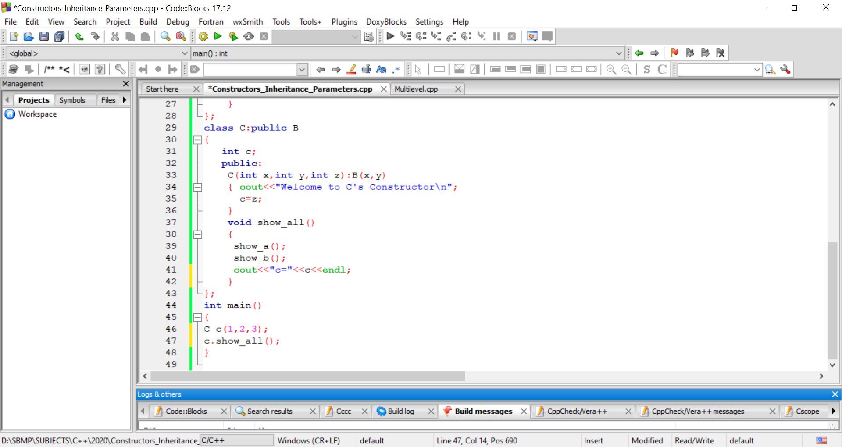
Passing arguments to constructors

Slide 67
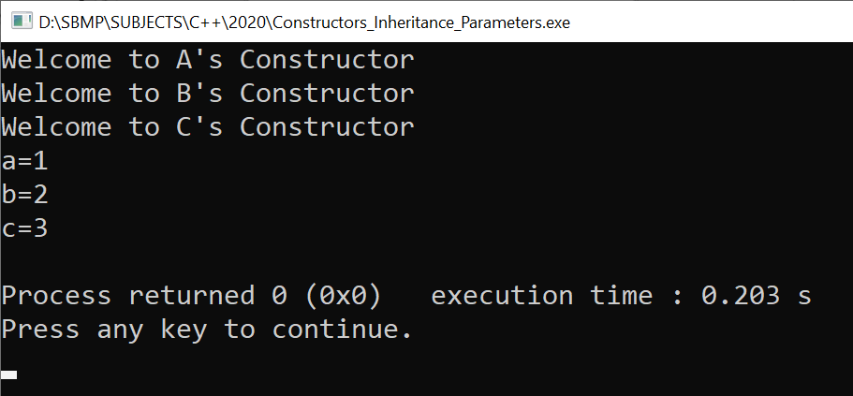
Passing arguments to constructors

Slide 68
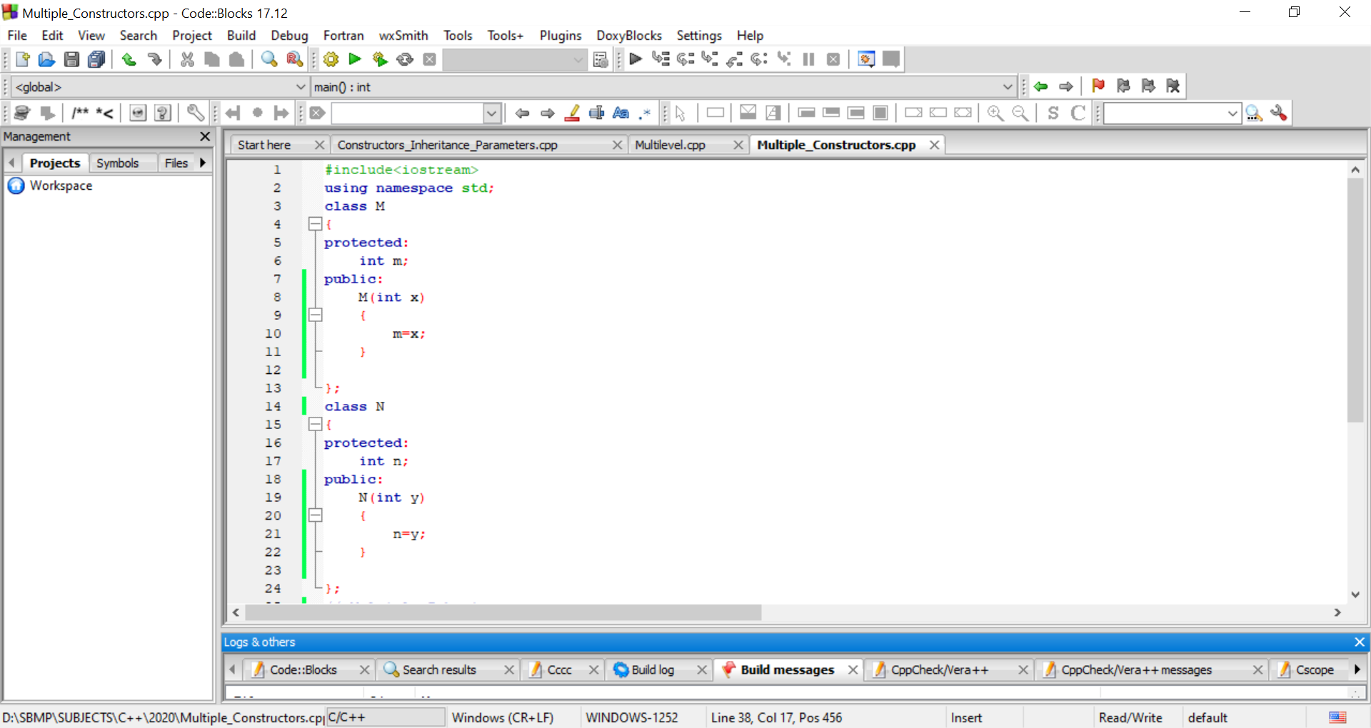
Constructors in Multiple Inheritance

Slide 69
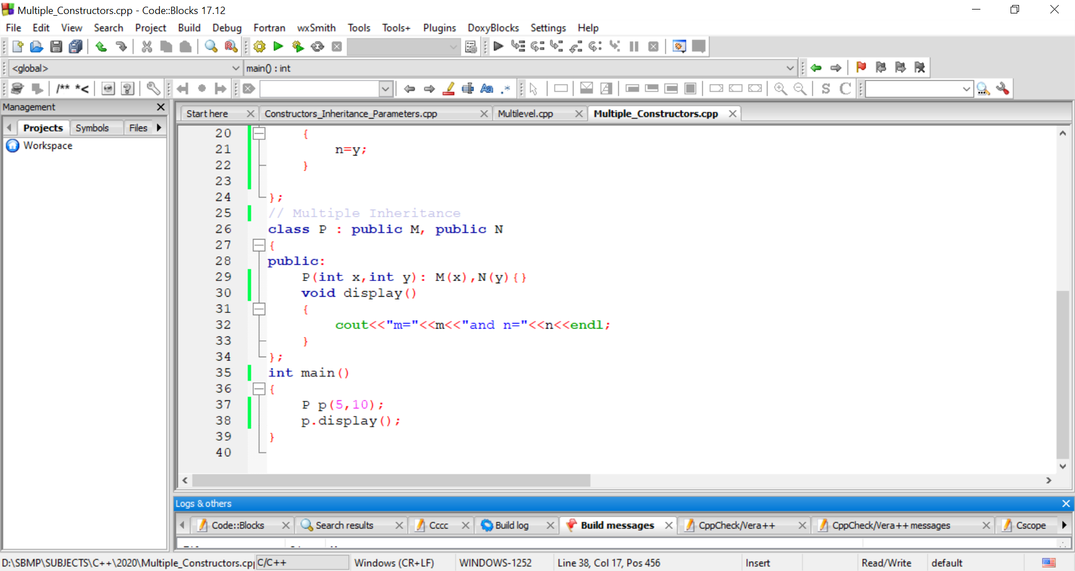
Constructors in Multiple Inheritance

Slide 70



Slide 71


Thank You
Kingsoft Office
published by www.Kingsoftstore.com
@Kingsoft_Office
kingsoftstore

